Slide 2

Topics
Procedural and Object-Oriented Programming
Classes
Working with Instances
Techniques for Designing Classes

Slide 3
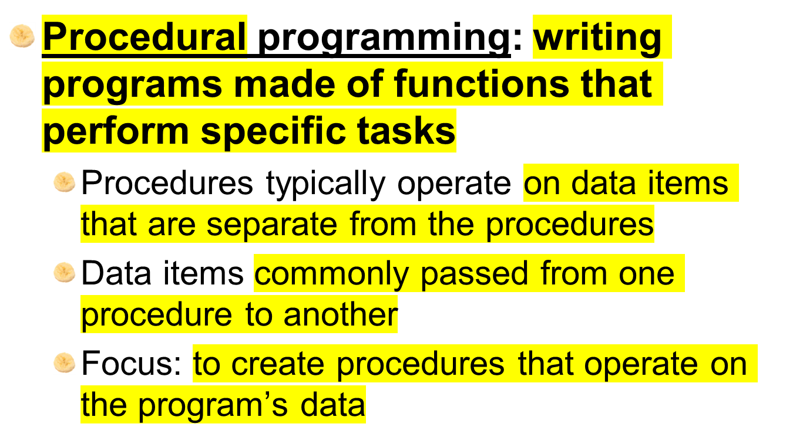
Procedural Programming

Slide 4
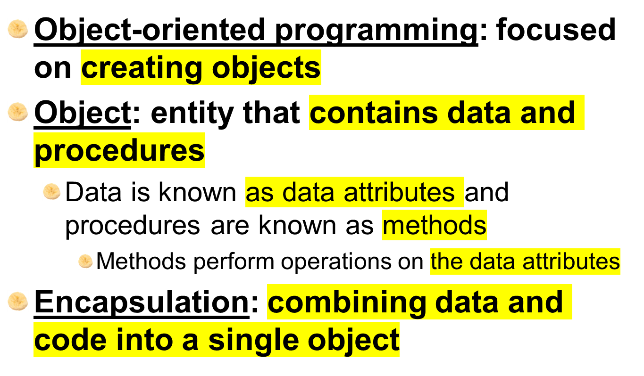
Object-Oriented Programming

Slide 5
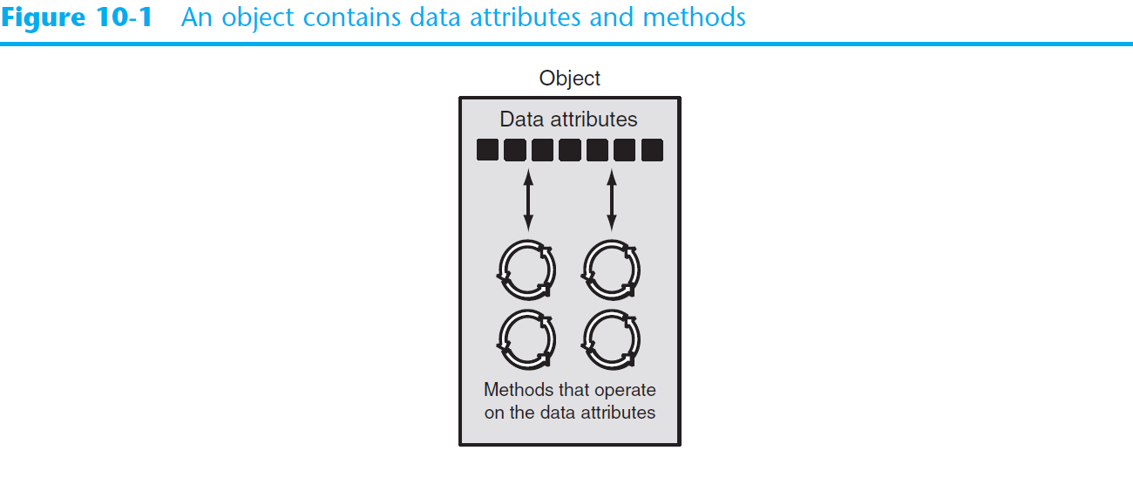
Object-Oriented Programming (cont’d.)

Slide 6
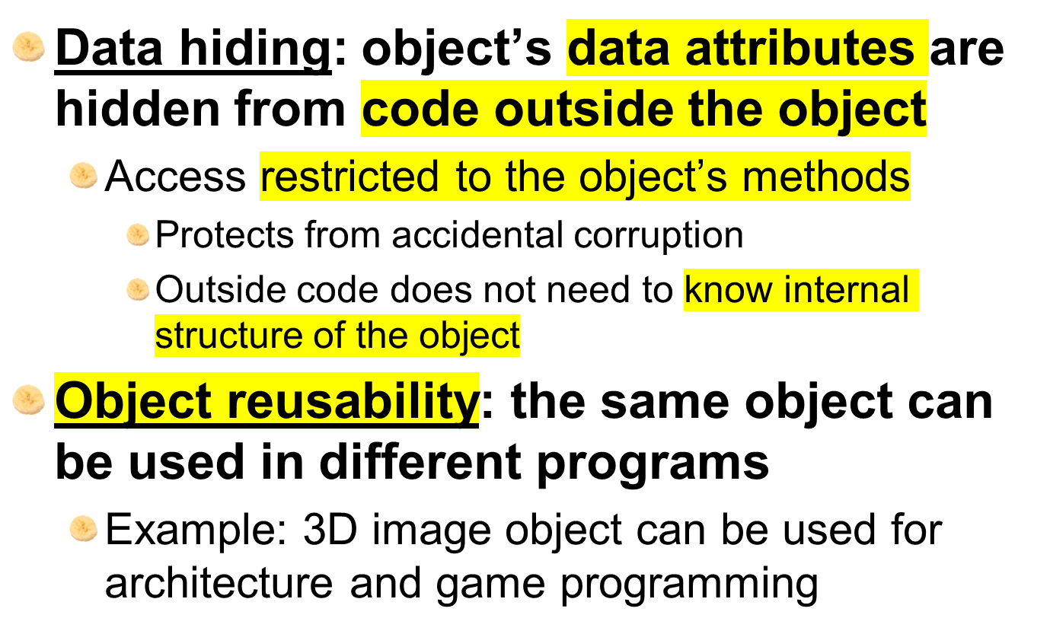
Object-Oriented Programming (cont’d.)

Slide 7
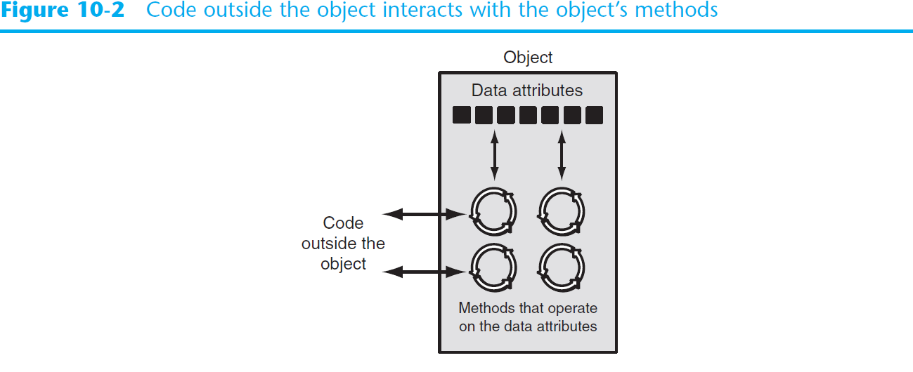
Object-Oriented Programming (cont’d.)

Slide 8
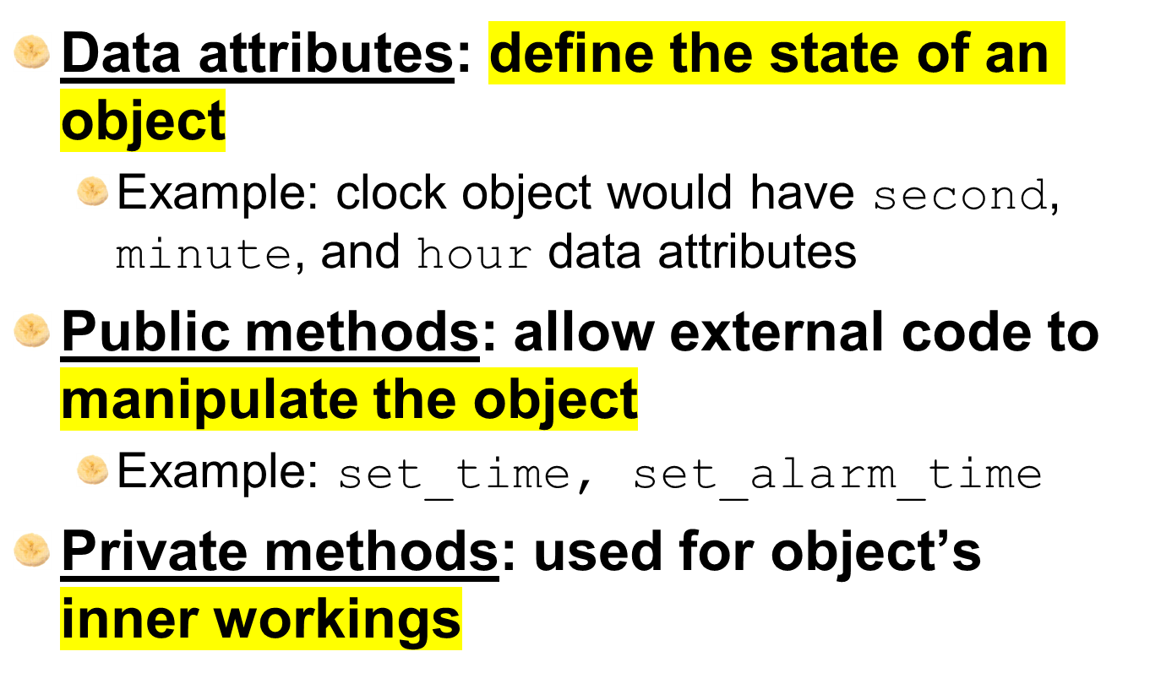
An Everyday Example of an Object

Slide 9
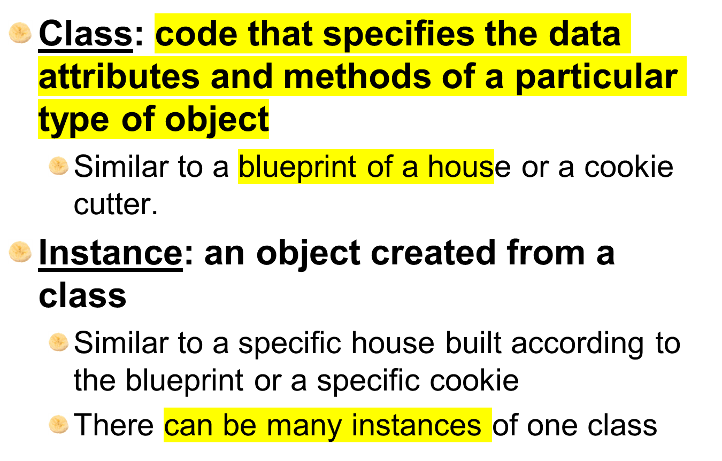
Classes

Slide 10
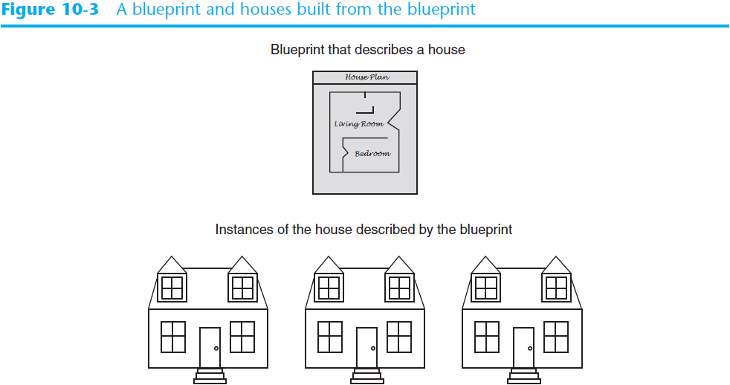
Classes (cont’d.)

Slide 11
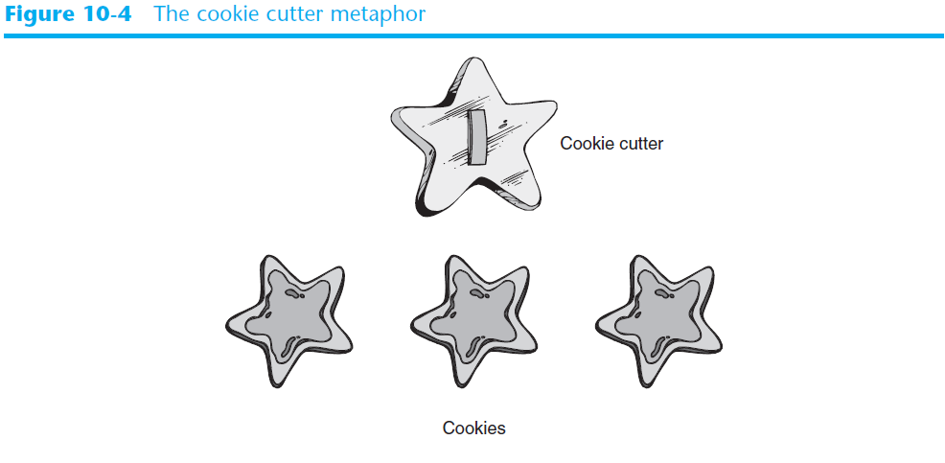
Classes (cont’d.)

Slide 12
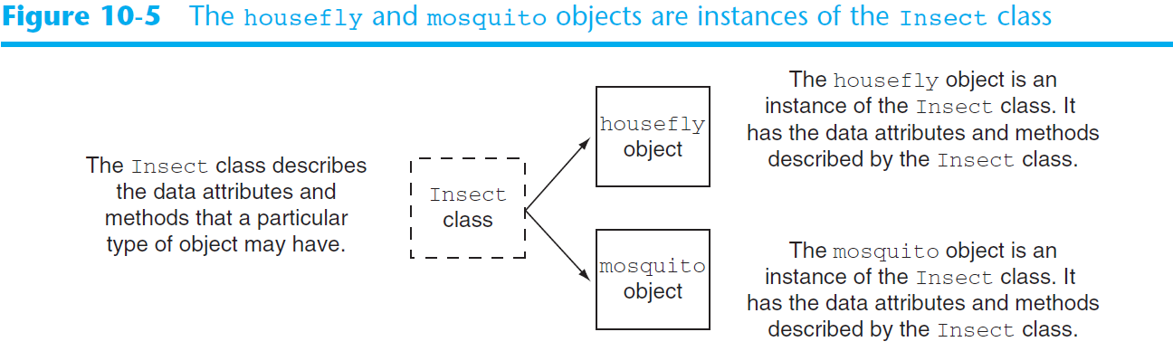
Classes (cont’d.)

Slide 13
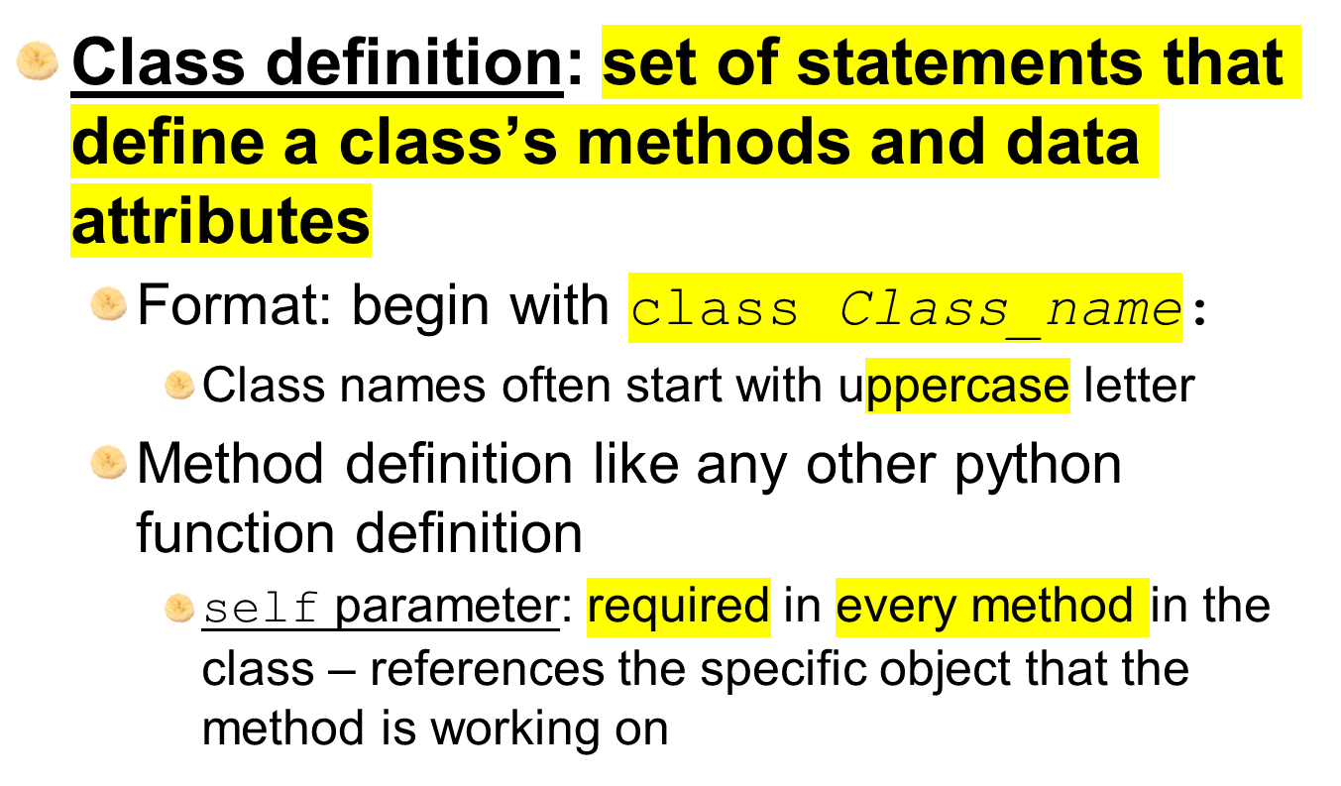
Class Definitions

Slide 14
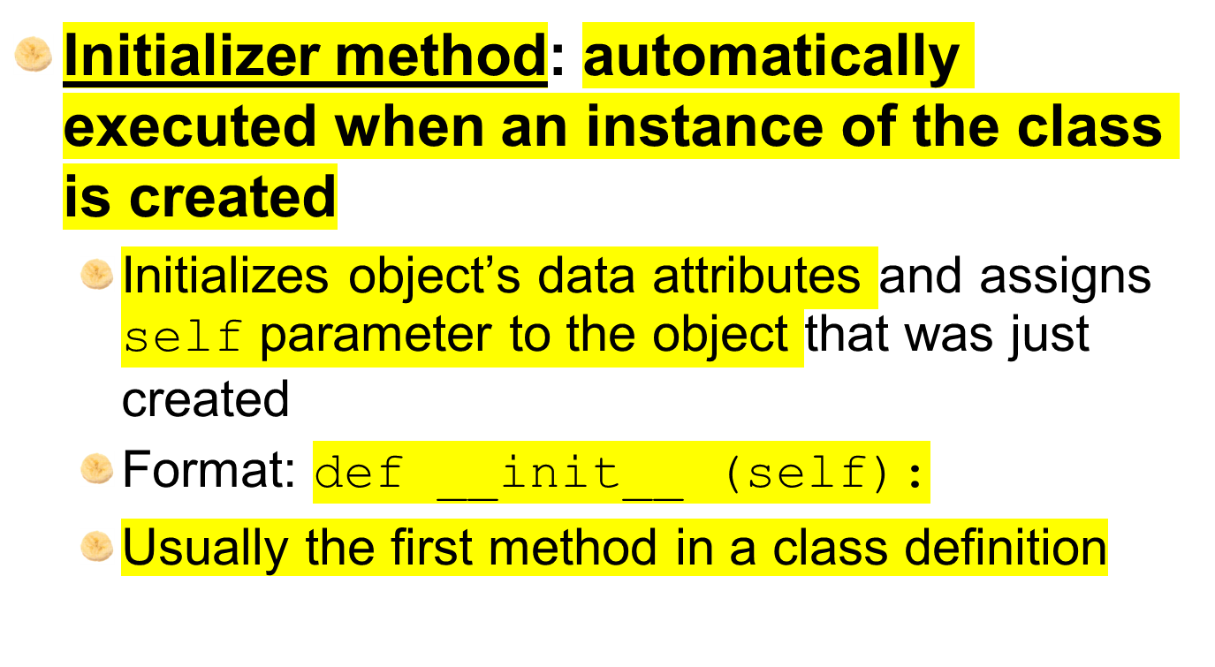
Class Definitions (cont’d.)

Slide 15
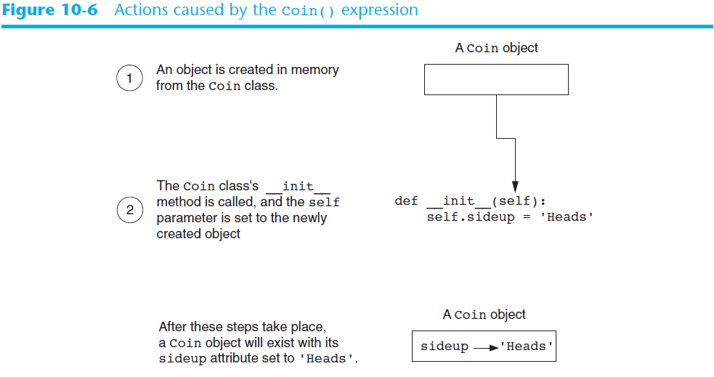
Class Definitions (cont’d.)

Slide 16
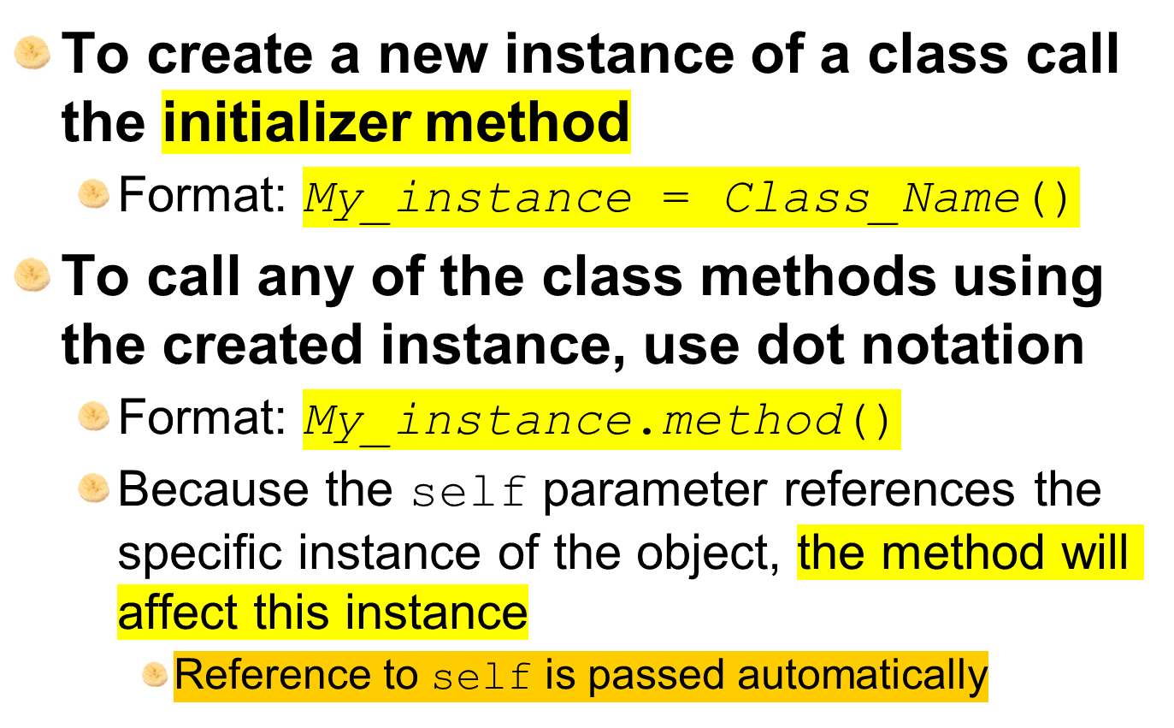
Class Definitions (cont’d.)

Slide 17
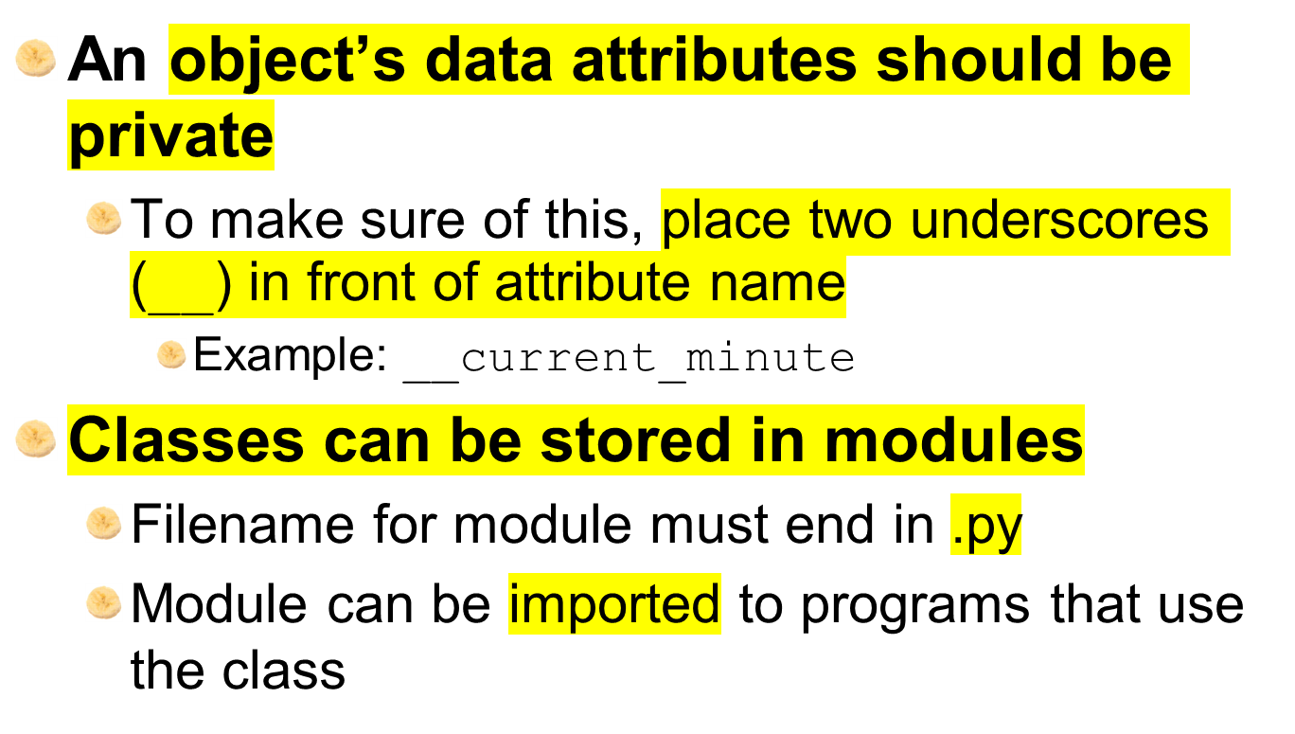
Hiding Attributes and Storing Classes in Modules

Slide 18
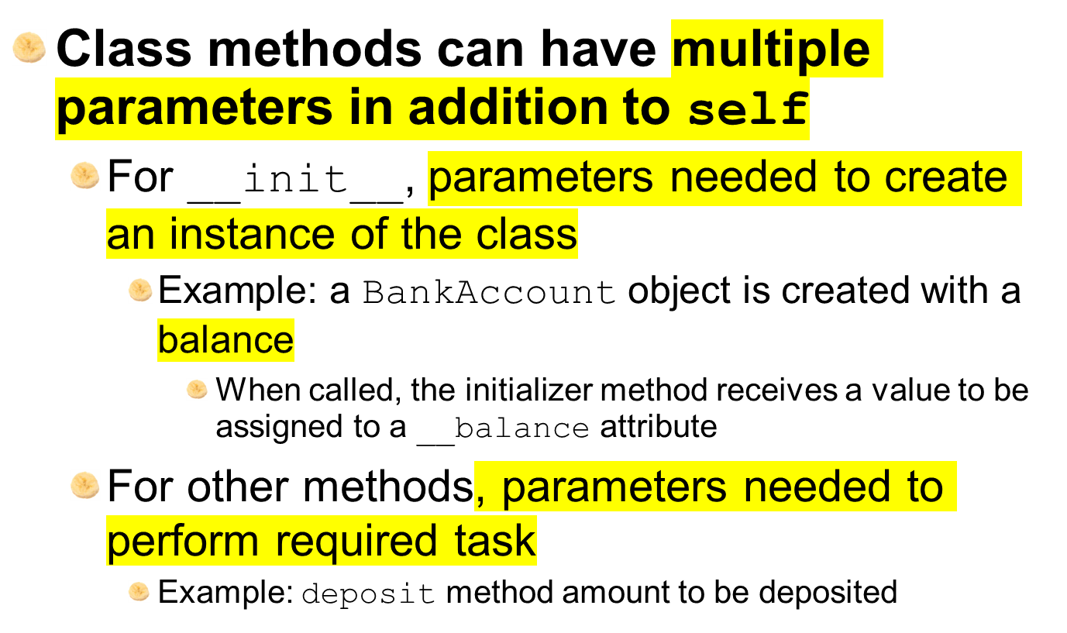
The BankAccount Class – More About Classes

Slide 19
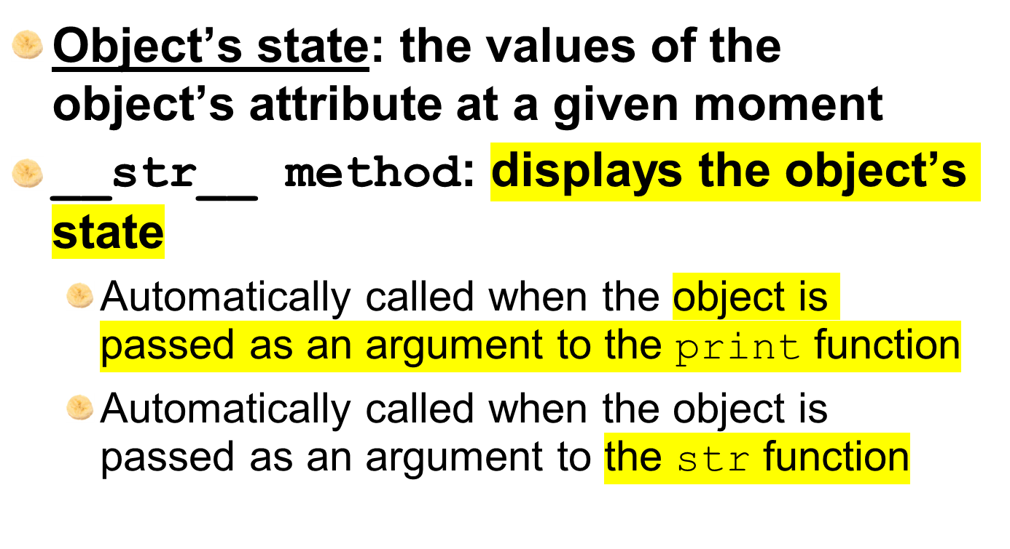
The __str__ method

Slide 20
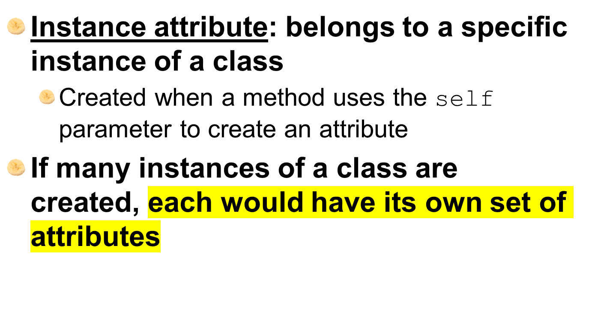
Working With Instances

Slide 21
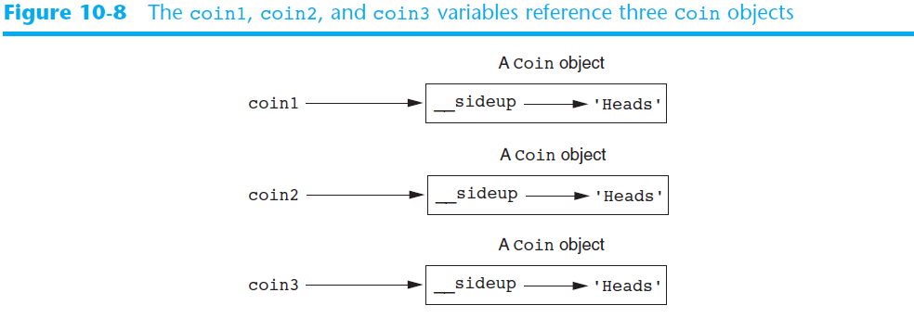
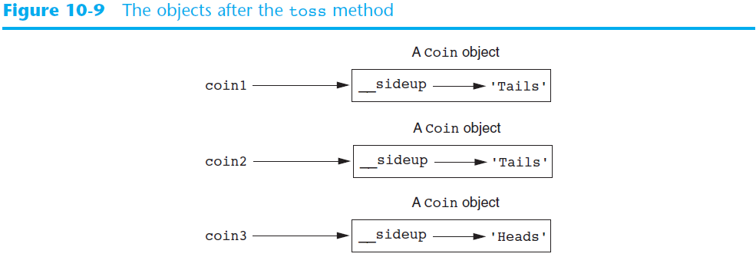

Slide 22
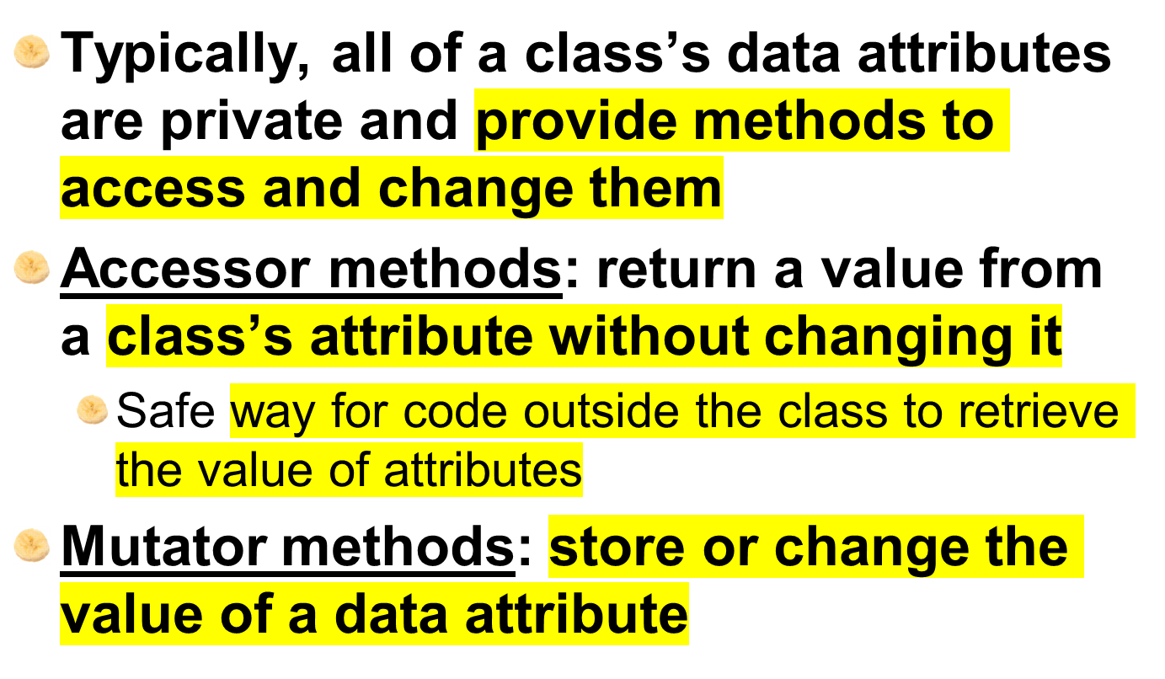
Accessor and Mutator Methods

Slide 23
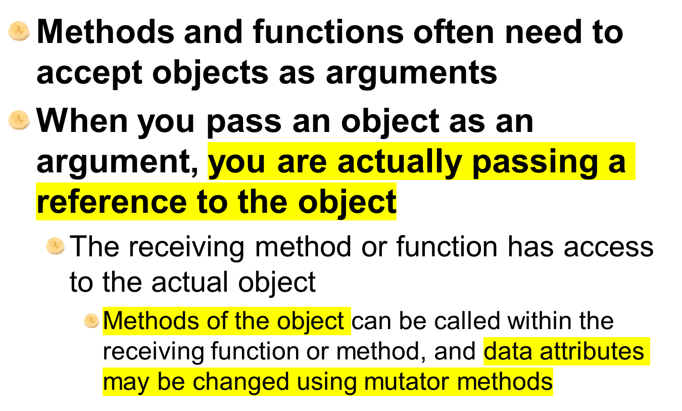
Passing Objects as Arguments

Slide 24
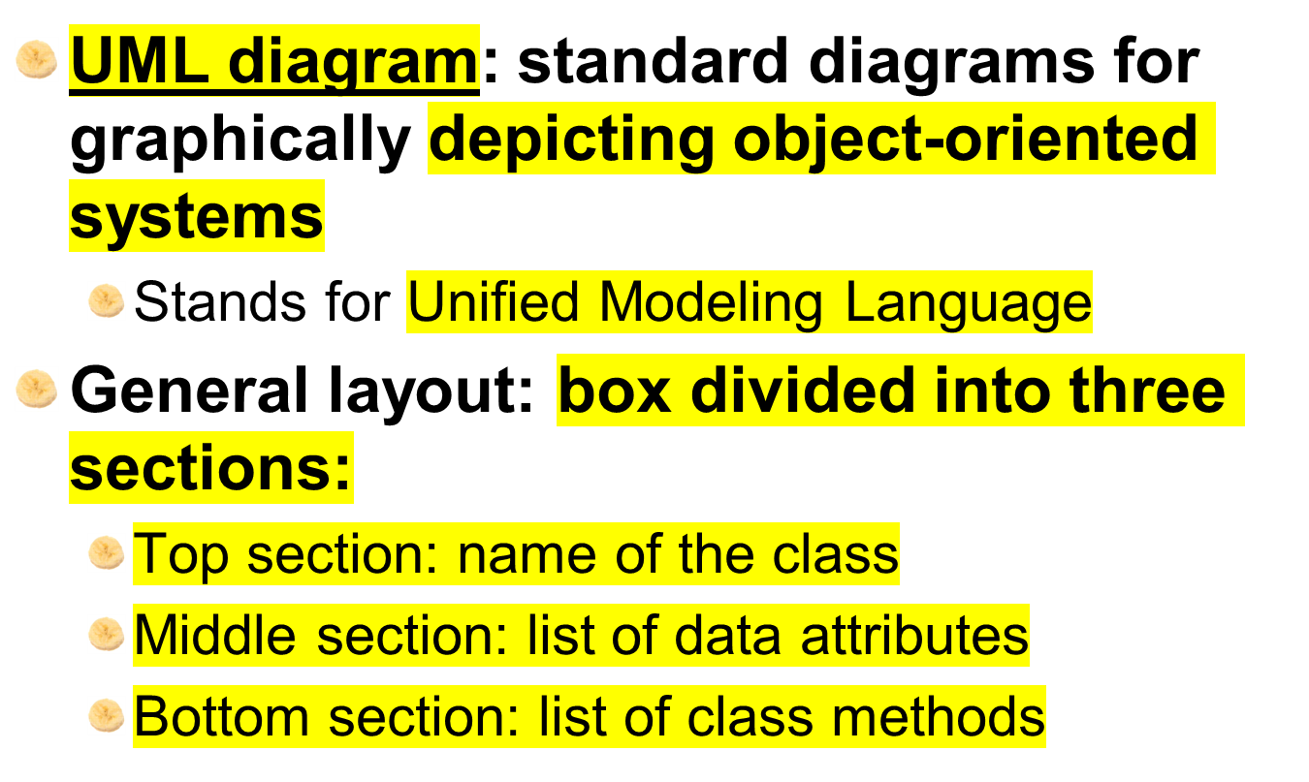
Techniques for Designing Classes

Slide 25
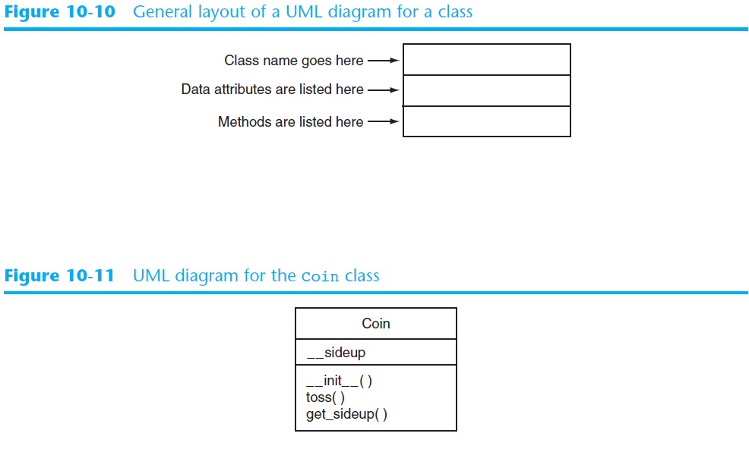

Slide 26
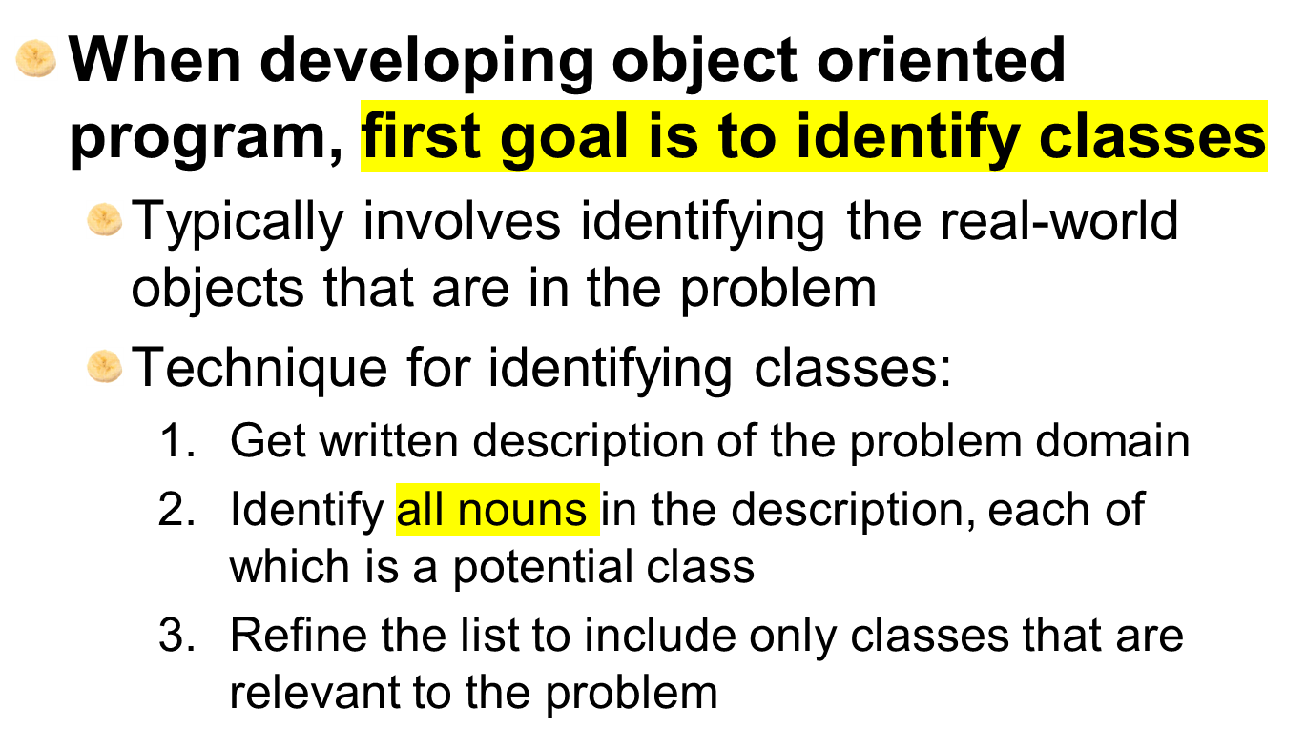
Finding the Classes in a Problem
Notes:
Object oriented programs -> identify classes -> get written description of the problem-> identify all nouns ‘s list -> refine the list and include classes relevant to the problem

Slide 27
Finding the Classes in a Problem (cont’d.)
Get written description of the problem domain
  May be written by you or by an expert
  Should include any or all of the following:
    Physical objects simulated by the program
    The role played by a person
    The result of a business event
    Recordkeeping items

Slide 28
Finding the Classes in a Problem (cont’d.)
Identify all nouns in the description, each of which is a potential class
  Should include noun phrases and pronouns
  Some nouns may appear twice

Slide 29
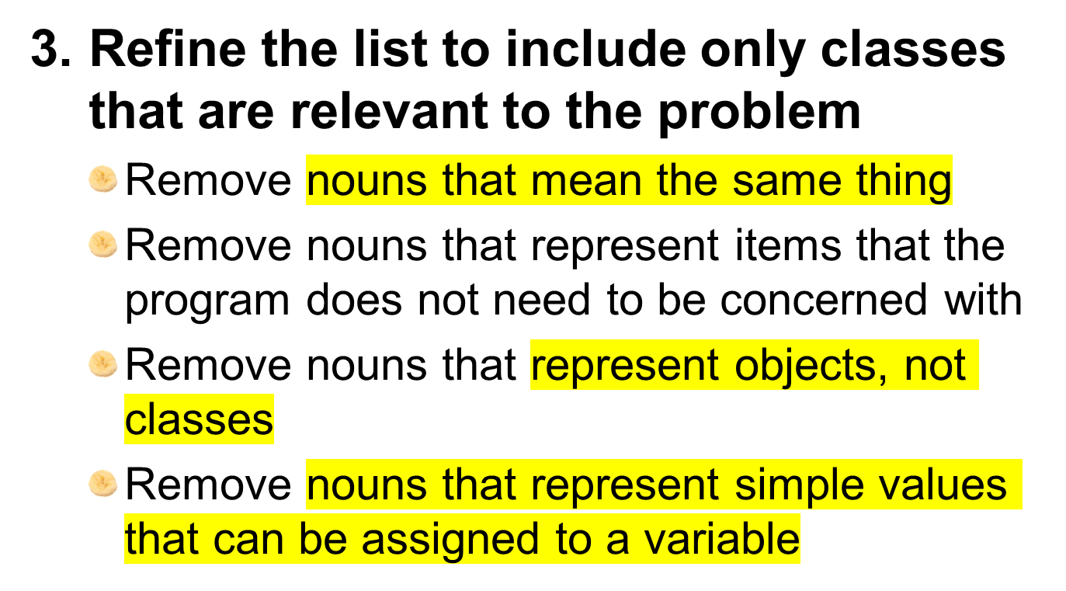
Finding the Classes in a Problem (cont’d.)

Slide 30
Identifying a Class’s Responsibilities
A classes responsibilities are:
  The things the class is responsible for knowing
    Identifying these helps identify the class’s data attributes
  The actions the class is responsible for doing
    Identifying these helps identify the class’s methods
To find out a class’s responsibilities look at the problem domain
  Deduce required information and actions

Slide 31
Summary
This chapter covered:
  Procedural vs. object-oriented programming
  Classes and instances
  Class definitions, including:
    The self parameter
    Data attributes and methods
    __init__ and __str__ functions
    Hiding attributes from code outside a class
  Storing classes in modules
  Designing classes

